Slide 1

Keys, Virtual DOM, Routing
Single Page Applications,
Blueprint for SPA
SoftUni Team
Technical Trainers
Software University
http://softuni.bg

Slide 2

Table of Contents
Keys and Virtual DOM
Routing Overview
React-router
Lazy Loading

Slide 3
Have a Question?
sli.do #js-web

Slide 4

Keys and Virtual DOM
Identify items, Reconciliation

Slide 5
Keys Overview
Keys help React identify which items have changed, are added, or are removed
Keys should be given to the elements inside the array to give the elements a stable identity:
const numbers = [1, 2, 3, 4, 5];
const listItems = numbers.map((number) =>
<li key={number.toString()}>
{number}
</li>
);

Slide 6
Picking a Key
The best way to pick a key is to use a string that uniquely identifies a list item among its siblings
Most often you would use IDs from your data as keys:
const todoItems = todos.map((todo) =>
<li key={todo.id}>
{todo.text}
</li>
);

Slide 7
Extracting Components with Keys
Keys only make sense in the context of the surrounding array
function NumberList(props) {
const numbers = props.numbers;
const listItems = numbers.map((number) =>
<ListItem key={number.toString()}
value={number} />
);
return (
<ul>
{listItems}
</ul>
);
}
Keep the key on the list item
function ListItem(props) {
return <li>{props.value}</li>;
}

Slide 8
Virtual DOM
React keeps track of all elements in a virtual DOM
On change, a diffing algorithm is applied
Only the needed parts are updated in the browser
More info at: reactjs.org/docs/reconciliation.html
React syntax is declarative
You only describe the desired result
ReactDOM takes care of the order of operations

Slide 9
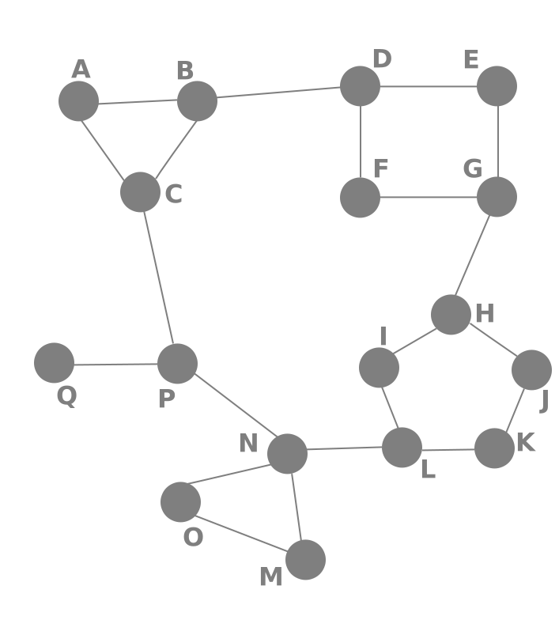
Routing Overview
Navigation for Single Page Apps

Slide 10


What is Client-side Routing?
Routing allows navigation, without reloading the page
It's a pivotal element of writing Single Page Applications
Link
HTML
Router
Link
Link
Link
Standard Navigation
Client-side Routing

Slide 11

Single Page Applications
A Router loads the appropriate content when the location changes
E.g. when the user manually enters an address
Conversely, a change in content is reflected in the address bar
E.g. when the user clicks on a link
Benefits:
Load all scripts only once
Maintain state across multiple pages
Browser history can be used
Build User Interfaces that react quickly

Slide 12

React-Router
Routing Library Tailored for React

Slide 13
What is React Router?
React Router is a complete routing library for React
Keeps the UI in sync with the URL
const App = (<div>
<Route path="/catalog" component={Catalog}/>
<Route path="/about" component={About}/>
</div>);
ReactDOM.render((
<BrowserRouter>
<App />
</BrowserRouter>
), document.getElementById('root'))

Slide 14
Installation and Setup
Install using npm from the terminal
Import modules in your app
Official documentation
npm install --save react-router
import { BrowserRouter } from 'react-router-dom';
import { Route, Link } from 'react-router-dom';
https://reacttraining.com/react-router/web/guides/philosophy

Slide 15
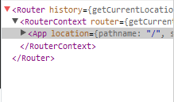
Rendering a Route
React Router is a component
It can be rendered as any React component
React components can be nested in it as normal
render(<BrowserRouter/>, document.getElementById('app'))
render((
<BrowserRouter>
<App />
</BrowserRouter >
), document.getElementById('app'))

Slide 16
Adding More Scenes
React components can be wrapped in a Route and bound to a specific path
Access URL
<Router history={hashHistory}>
<Route path="/" exact component={App}/>
<Route path="/catalog" component={Catalog}/>
<Route path="/about" component={About}/>
</Router>
Component to load

Slide 17
Navigating with Link
Link replaces <a> and automatically prevents page reload
class App extends Component {
render() {
return (<div><h1>React Router Tutorial</h1>
<Link to="/catalog">Catalog</Link>
<Link to="/about">About</Link>
</div>);
}
}
Access URL as defined in Route

Slide 18
Nested Routes
You can dynamically nest routes
const About = ({match}) => (
<div>
<h1>About Page</h1>
<Route
path={match.url + '/contact'}
component={Contact} />
</div>
)
Access match URL to
create a relative path
Contact will be rendered at '/about/contact '

Slide 19
Active Links
NavLink knows when it's currently active
We can style them with activeStyle or activeClassName
<NavLink to="/catalog" activeStyle={{ color: 'red' }}>
Catalog
</NavLink >
<NavLink to="/catalog" activeClassName="activeNav">
Catalog
</NavLink>

Slide 20
Exclusive Rendering
By default, if two Routes match, both will be rendered
Switch renders only the first match
<Switch>
<Route path="/" exact component={Home}>
<Route path="/about" component={About}/>
<Route path="/:user" component={User}/>
<Route component={NotFoundRoute}/>
</Switch>
Default route

Slide 21
URL Params
Parameters are dynamic parts of the URL
Example: /catalog/elecronics/XYZ5538
Configure the Route to work with params
Access from the component
This part of the URL can change
<Route path="/catalog/:category/:userId" component={Catalog}/>
this.props.match.params.category

Slide 22
Redirects
You can redirect the user by rendering a Redirect component
Determine the component to render at run-time
<Route exact path="/" render={() => (
loggedIn ? (<Redirect to="/dashboard" />)
: (<PublicHomePage />)

Slide 23

Lazy Loading
Code-Splitting, Bundling, React.lazy

Slide 24
Code-Splitting - Bundling
Most React apps will have their files "bundled" using tools like Webpack or Browserify
Bundling is the process of following imported files and merging them into a single file: a "bundle".
This bundle can then be included on a webpage to load an entire app at once
export function add(a, b) {
return a + b;
}
import { add } from './math.js';
console.log(add(16, 26));

Slide 25
Dynamic Import
The best way to introduce code-splitting into your app is through the dynamic import() syntax:
import { add } from './math';
console.log(add(16, 26));
import("./math").then(math => {
console.log(math.add(16, 26));
});

Slide 26
Using React.lazy
The React.lazy function lets you render a dynamic import as a regular component
const OtherComponent = React.lazy(() => import('./OtherComponent'));
function MyComponent() {
return (
<div>
<OtherComponent />
</div>
);
}

Slide 27
Suspense – Showing Indicators
The Suspense component shows fallback content while we're waiting for another component to load:
function MyComponent() {
return (
<div>
<Suspense fallback={<div>Loading...</div>}>
<OtherComponent />
</Suspense>
</div>
);
}
Accepts any React element

Slide 28
Route-based code splitting
An example of how to setup route-based code splitting
const App = () => (
<Router>
<Suspense fallback={<div>Loading...</div>}>
<Switch>
<Route exact path="/" component={Home}/>
<Route path="/about" component={About}/>
</Switch>
</Suspense>
</Router>
);

Slide 29

Summary
Keys help React identify which items have changed, are added, or are removed
Client-side routing improves UX
React-router is a routing library tailored for React
const App = (props) => (
<div>
<Route path="/catalog" component={Catalog}/>
<Route path="/about" component={About}/>
</div>
);

Slide 30
https://softuni.bg/opencourses/reactjs-fundamentals

Slide 31













SoftUni Diamond Partners

Slide 32




SoftUni Organizational Partners

Slide 33




Trainings @ Software University (SoftUni)
Software University – High-Quality Education and Employment Opportunities
softuni.bg
Software University Foundation
http://softuni.foundation/
Software University @ Facebook
facebook.com/SoftwareUniversity
Software University Forums
forum.softuni.bg

Slide 34

License
This course (slides, examples, demos, videos, homework, etc.) is licensed under the "Creative Commons Attribution-NonCommercial-ShareAlike 4.0 International" license

